Slide 1
Agile in a Highly Regulated Organization: part 2
Tami Flowers
KCDC - May 16, 2014

Slide 2
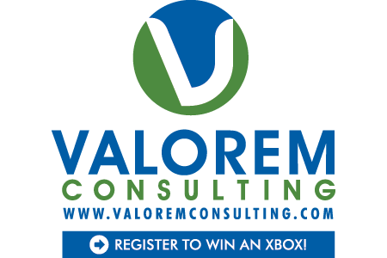



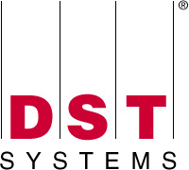



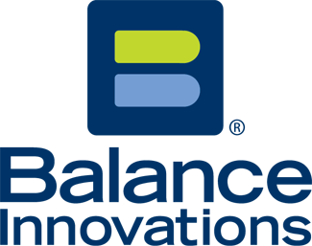

























Titanium Sponsors
Platinum Sponsors
Gold Sponsors

Slide 3
Highly Regulated Environment
I worked for a company with these words in it’s name:
Federal
Home Loan
Bank
That meant we had to consider
Sarbanes Oxley Act (SOx)
COBIT
= internal auditors, external auditors, internal risk management group, examiners
= 6-9 months a year of being audited or examined

Slide 4
Today’s Discussion
How adding service levels to your SDLC based on project size or characteristics can help.
Examples of artifacts for each service level and how to map them back to controls.
How a governance group to interface with auditors or examiners can help ease your pain.
What types of things do auditors/examiners ask for and how to prepare.
Lessons learned.

Slide 5
Regulations do not tell you how to build software
Controls, not the HOW or the process, is the focus.
As long as your process can show
the controls,
that the controls are implemented and tested
Then the process you use to build software is up to you and your organization.

Slide 6
Types of sox controls
Business units
Any business department that impacts financial statements
Accounting
Finance
HR (executive compensation, etc.)
IT
IT general controls
IT application controls

Slide 7
IT general controls
Control environment, designed to shape the “tone at the top”
Change management procedure
Source code/document version
Software development life cycle standards
Logical access policies
Incident management policies and procedures (operational processing)
Problem management policies and procedures
Technical support policies and procedures
Hardware/software configuration, installation, testing
Disaster recovery/backup recover procedures
Physical security

Slide 8
It application controls
Completeness checks – records processed end to end
Validity checks – only valid data input or processed
Identification – all users uniquely and irrefutably identified
Authentication – mechanism in application system
Authorization – only approved users have access
Input controls – ensure data integrity fed from upstream sources
Forensic controls – data scientifically and mathematically correct

Slide 9
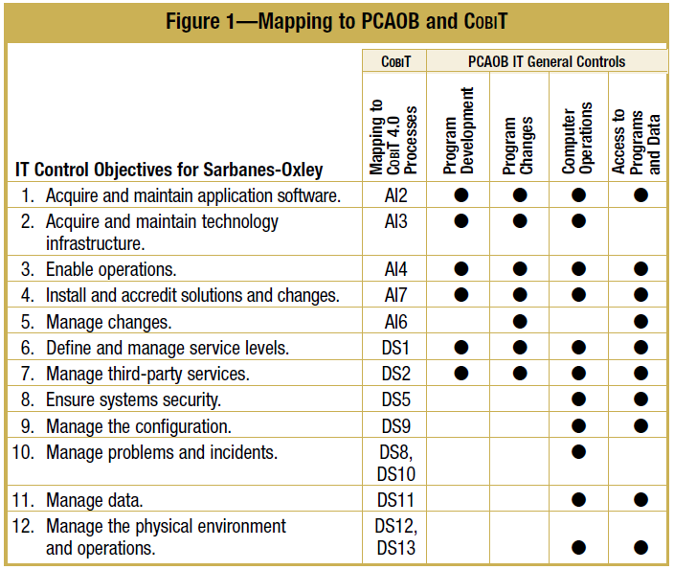
In all, 12 IT control objectives, which align to the Public Company Accounting Oversight Board
(PCAOB) Auditing Standard No. 2 and Control Objectives for Information and related Technology (COBIT ®), were defined for Sarbanes-Oxley. Figure 1 provides a high-level mapping of the IT control objectives for Sarbanes-Oxley described in the IT Control Objectives for Sarbanes Oxley , 2nd edition document, IT general controls identified by the PCAOB and the COBIT 4.0 processes.
Notes:
Public Company Accounting Oversight Board

Slide 10
Business controls
Things that impact financial statements
Business units should have these documented
Talk to your CFO

Slide 11
Project Lifecycle
Identify the controls at each lifecycle stage.
Business controls
IT general controls
IT application controls
Update your SDLC and identify the controls and how you are going to prove that the control was met, tested, or validated.
Feasibility
Release Planning
Iterate
Close Out
Initiation

Slide 12
Service Level Agreements (SLA)
Our friends at Wikipedia say:
A service-level agreement is an agreement between two or more parties, where one is the customer and the others are service providers.
Use them in your SDLC to define service levels
Applicable controls
The required deliverables or documentation
As projects are requested, have the requestor define the SLA

Slide 13
Service levels
Determine what makes sense in your organization to distinguish between levels. Examples include:
The type of change being requested
data change versus code/functionality change vs minor software upgrade
Will the request impact a SOx key control or financial information posted to the General Ledger (Accounting/Financial Reporting)
Is the change being made to a SOx critical IT application
Level of effort in terms of scope and business unit/developer time to implement the request
Cost
# of resources
time
Required deliverables and controls vary between the service levels

Slide 14
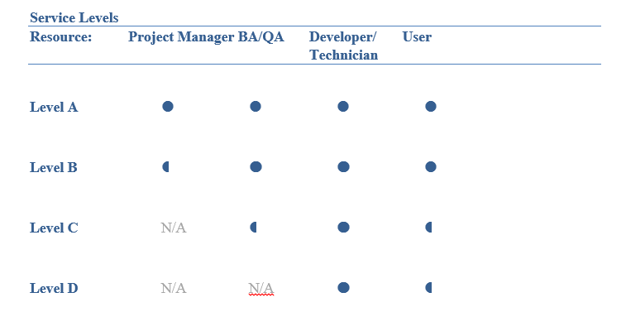
Service Levels

Slide 15
Show and tell

Slide 16
Where to test controls
Release plan with the controls identified in stories
Test plan with specific test identified to test or validate controls

Slide 17
A governance group can help
Interface between IT and auditors/examiners
Set agreed upon deadlines for response to findings
Focused on controls and keeping them updated
Continuous monitoring of adherence
Keep IT aware of findings, any needed action and deadlines
Ensure IT is trained and aware of control deliverables

Slide 18
Examiners, auditors, oh my
Things they wanted to know
What is our SDLC
Controls within the SDLC
Prove that the control was implement/tested
Show us the documentation to prove it was tested
If it wasn’t documented, it didn’t happen
Show screen shots of anything with calculations, money, etc.
Normally we knew ahead of time what they wanted to review
Responding to requests
Pull documentation they request; normally they’ll request a release or project
Save it to a location they can get to
Responding to findings
Material vs immaterial
Will need to take action on the material findings; they will be disclosed on financial statements
May be told that the immaterial will become material if not resolved

Slide 19
Lessons learned
Perform periodic internal testing of IT controls
Resolve any findings ahead of audits/exams
Governance of this is a full time job
Use a team to work through the controls and documentation within the SDLC – include governance and multiple roles (Dev, BA, QA, Architecture, PM)

Slide 20
Me
Twitter: TamiLFlowers
LinkedIn: Tami Flowers
Slideshare: www.slideshare.net\tamiflowers
Thanks!

